Slide 1

Align before Fuse: Vision and Language Representation Learning with Momentum Distillation
-code-
AAI Lab. 서원희, 최창수
Hanbat National University, Dept. of Computer Engineering

Slide 2
Index
Introduction
Code
Hanbat National University, Dept. of Computer Engineering

Slide 3
1. Introduction
Hanbat National University, Dept. of Computer Engineering

Slide 4
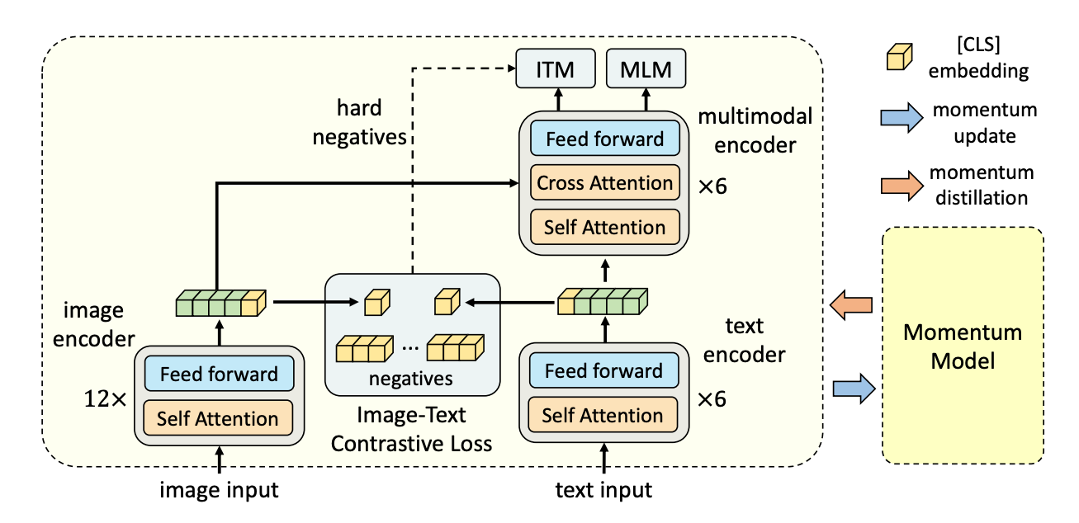
Introduction
제안 방법론 및 Contribution
ALign BEfore Fuse(ALBEF) 구조
Image encoder, Text encoder, Multimodal encoder로 구성됨
입력 이미지 는 , 입력 텍스트 는 임베딩으로 인코딩 됨
Image encoder: visual transformer ViT-B/16의 12-layer 사용
Text encoder: BERTbase 모델의 first 6-layer 사용
Multimodal encoder: BERTbase 모델의 last 6-layer사용
Multimodal encoder의 각 layer에서 cross attention을 통해 Image features와 Text feature를 Fusion
Hanbat National University, Dept. of Computer Engineering

Slide 5
Introduction
제안 방법론 및 Contribution
Pre-training Objectives
Image-Text Contrastive Learning(ITC)
멀티모달 인코더에서 image, text feature를 fusion하기 전 unimodal encoder를 학습 하는 것을 목적
같은 image-text pair(positive)로 부터 얻은 feature는 similarity가 높아지도록, 다른 image-text pair(negative)로 부터 얻은 features는 similarity가 낮아지도록 학습
ex) 만약 batch가 64라면, 하나의 image embedding에 대해 같은 pair인 text embedding은 similarity score가 높아지게, 나머지 negative text embeddings는 socre가 낮아지도록 학습 하는 것
Masked Language Modeling(MLM)
이미지와 mask를 씌우지 않은 text를 활용해 mask 씌운 단어를 맞추는 적을 목적
BERT와 마찬가지로 input tokens의 15%를 랜덤하게 마스크함
Image-Text Matching(ITM)
image-text pair가 positive(matched)인지 negative(not matched)인지 예측하는 objective
멀티모달 인코더의 [CLS] embedding을 fully-connected layer를 거친후 softmax로 matching 여부를 예측
Hanbat National University, Dept. of Computer Engineering

Slide 6
Introduction
Momentum Distillation
제안 방법론 및 Contribution
Pre-training에 사용되는 image-text 쌍은 대부분 웹에서 수집되며 Noise가 많은 경향이 있음.
Positive pairs는 텍스트가 이미지와 무관한 단어를 포함하거나 이미지가 텍스트에서 서술되지 않은 객체를 포함하는 등 보통 연관성이 약함.
ITC 학습의 경우 이미지에 대한 negative texts가 이미지의 내용과 일치할 수 있음.
MLM의 경우, 영상을 동일하게 잘 설명하는(또는 더 잘 설명하는) 원본의 주석과 다른 단어가 있을 수 있음. 그러나 ITC와 MLM에 대한 one-hot label은 정확성과 관계없이 모든 negative prediction에 벌칙을 부과함.
이를 위해 본 논문에서는 Momentum 모델에 의해 생성된 pseudo-target로부터 학습하는것을 제안
Momentum 모델: 유니모달, 멀티모달 인코더의 Exponential Moving Average(EMA)로 구성된 continuously-evolving teacher
타겟이 학습을 진행할 때 마다 업데이트 된다는것을 의미
Hanbat National University, Dept. of Computer Engineering

Slide 7
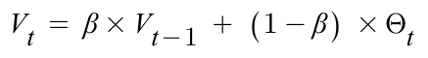
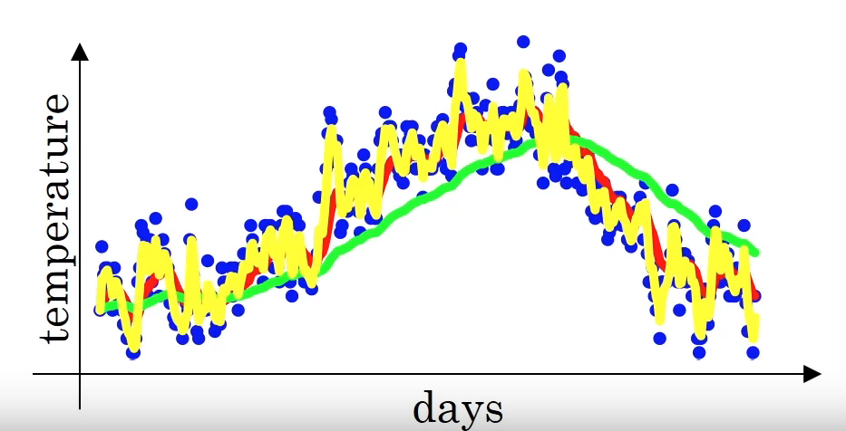
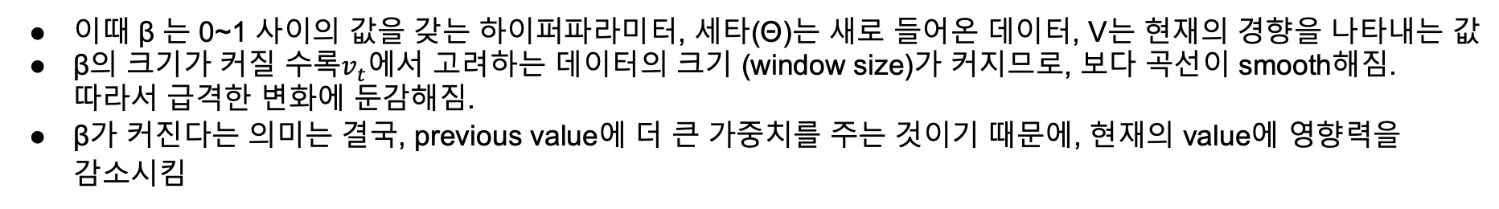
Introduction
What is EMA?
제안 방법론 및 Contribution
이때 β 는 0~1 사이의 값을 갖는 하이퍼파라미터, 세타(Θ)는 새로 들어온 데이터, V는 현재의 경향을 나타내는 값
β의 크기가 커질 수록$v_{t}$에서 고려하는 데이터의 크기 (window size)가 커지므로, 보다 곡선이 smooth해짐. 따라서 급격한 변화에 둔감해짐.
β가 커진다는 의미는 결국, previous value에 더 큰 가중치를 주는 것이기 때문에, 현재의 value에 영향력을 감소시킴
초록색 : β값이 높음, smooth
노란색 : β이 작음, 새로운 데이터에 adaptive해짐
Hanbat National University, Dept. of Computer Engineering

Slide 8
2. Code
Hanbat National University, Dept. of Computer Engineering

Slide 9
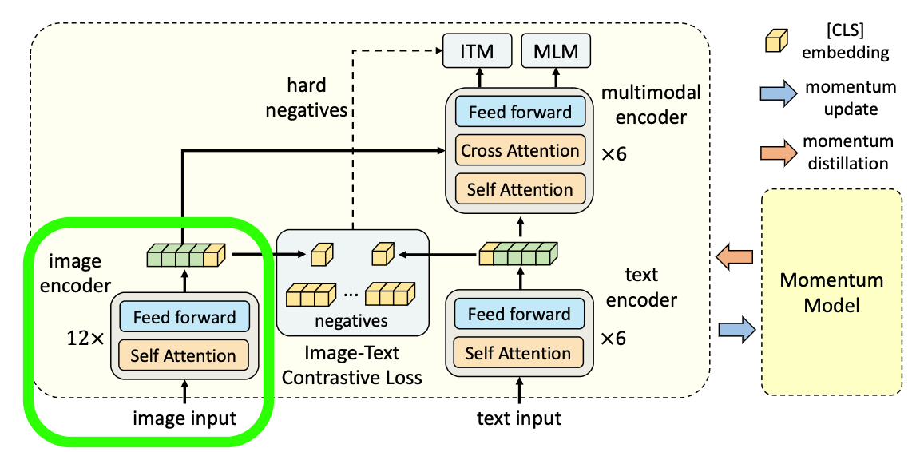
Code
Image encoder – Image data
Hanbat National University, Dept. of Computer Engineering

Slide 10
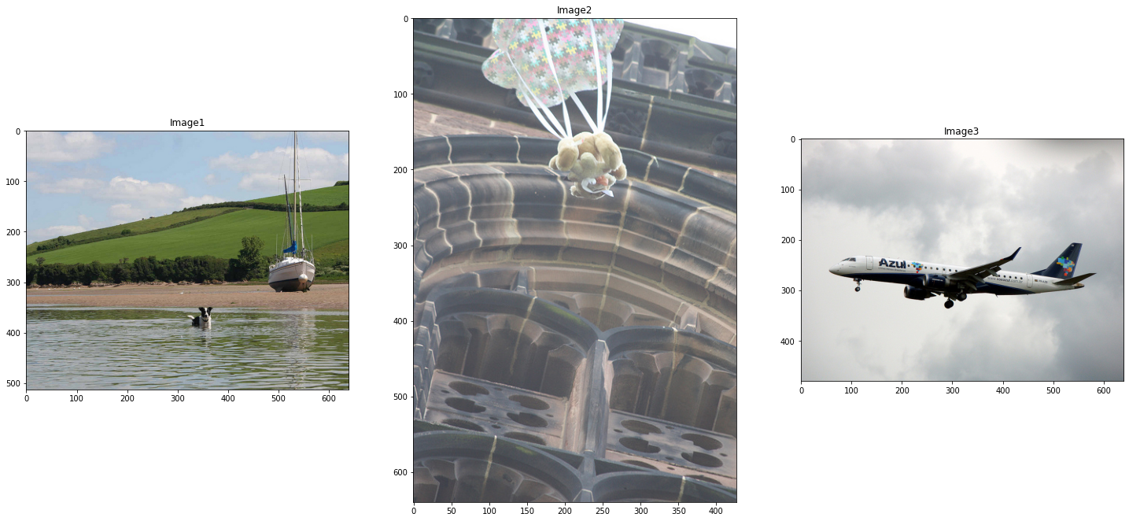
Code
Image encoder – Image data
"a stuffed animal with a parachute falling from above"
"The dog is swimming in the lake on a sunny day"
"A larger commerical jet is flying in the air"
Hanbat National University, Dept. of Computer Engineering

Slide 11
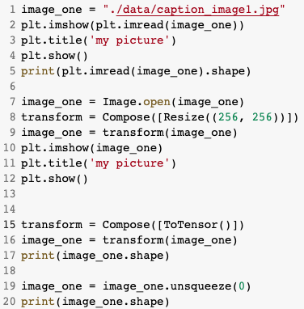
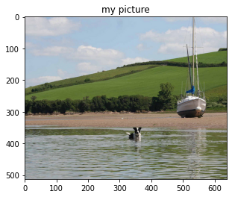
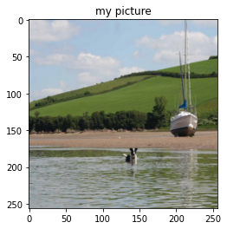
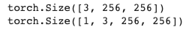
Code
Image encoder – Image data
Hanbat National University, Dept. of Computer Engineering

Slide 12
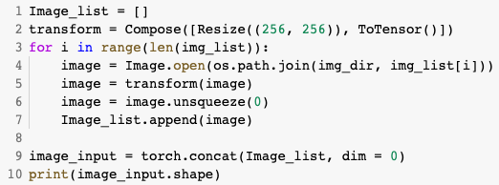
Code
Image encoder – Image data(3개의 그림에 적용)
Hanbat National University, Dept. of Computer Engineering

Slide 13
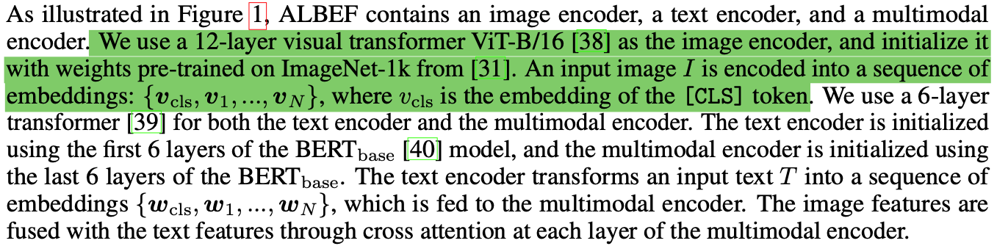
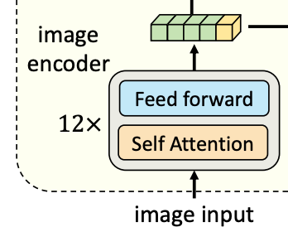
Code
Image encoder – input data of Image encoder
Hanbat National University, Dept. of Computer Engineering

Slide 14
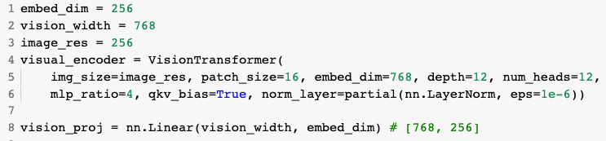
Code
Image encoder – ViT model & Initializing projection layer
Hanbat National University, Dept. of Computer Engineering

Slide 15
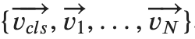
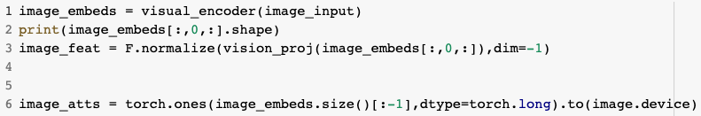
Code
Image encoder – Output of ViT model
입$력이미지 I→$
Hanbat National University, Dept. of Computer Engineering

Slide 16
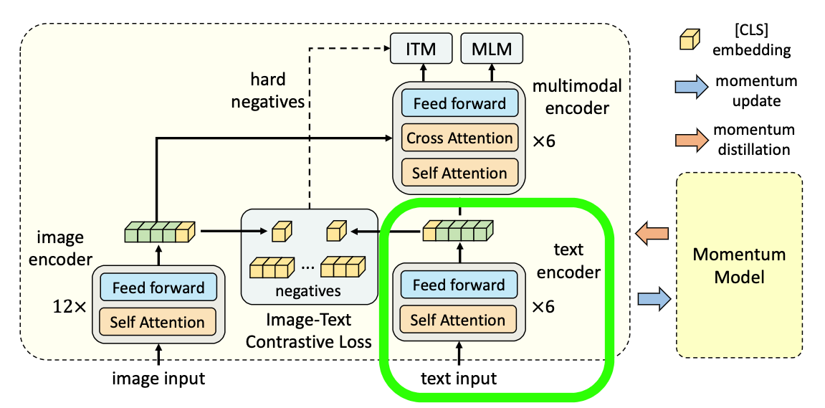
Code
Text encoder
Hanbat National University, Dept. of Computer Engineering

Slide 17
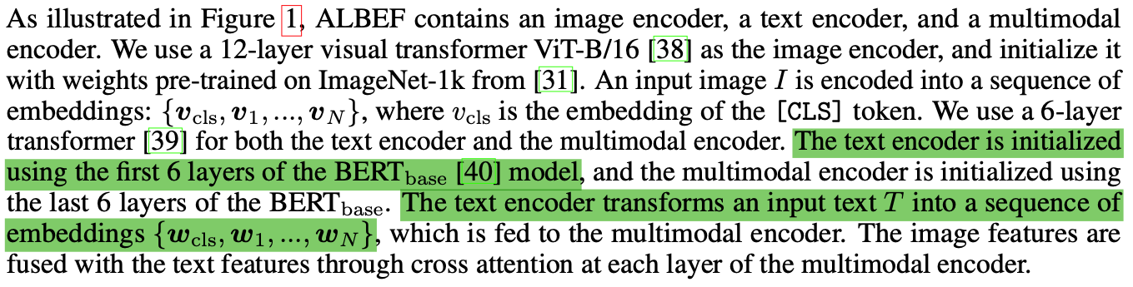
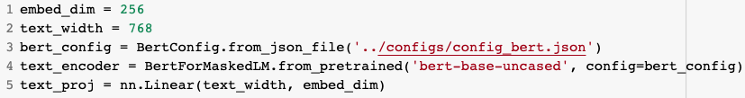

Code
Text encoder $BERT_{base}$ model & Initializing projection layer
Hanbat National University, Dept. of Computer Engineering

Slide 18
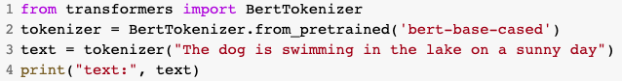
Code
Tokenizing text data
text: {'input_ids': [101, 1109, 3676, 1110, 5947, 1107, 1103, 3521, 1113, 170, 21162, 1285, 102],
'token_type_ids': [0, 0, 0, 0, 0, 0, 0, 0, 0, 0, 0, 0, 0],
'attention_mask': [1, 1, 1, 1, 1, 1, 1, 1, 1, 1, 1, 1, 1]}
Hanbat National University, Dept. of Computer Engineering

Slide 19
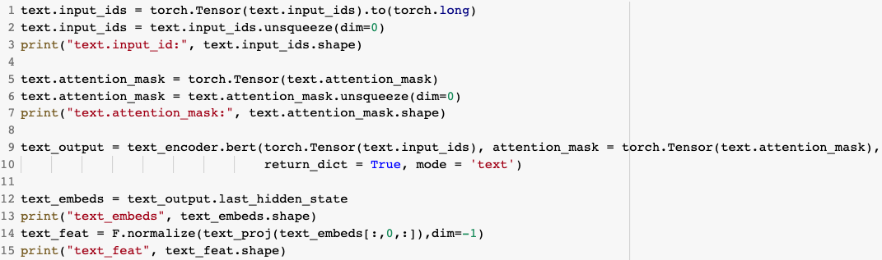
Code
Tokenized text data into model
Hanbat National University, Dept. of Computer Engineering

Slide 20
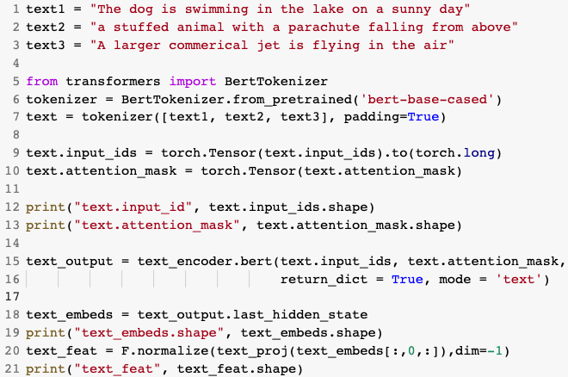
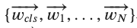
Code
Tokenized text data into model
Hanbat National University, Dept. of Computer Engineering

Slide 21
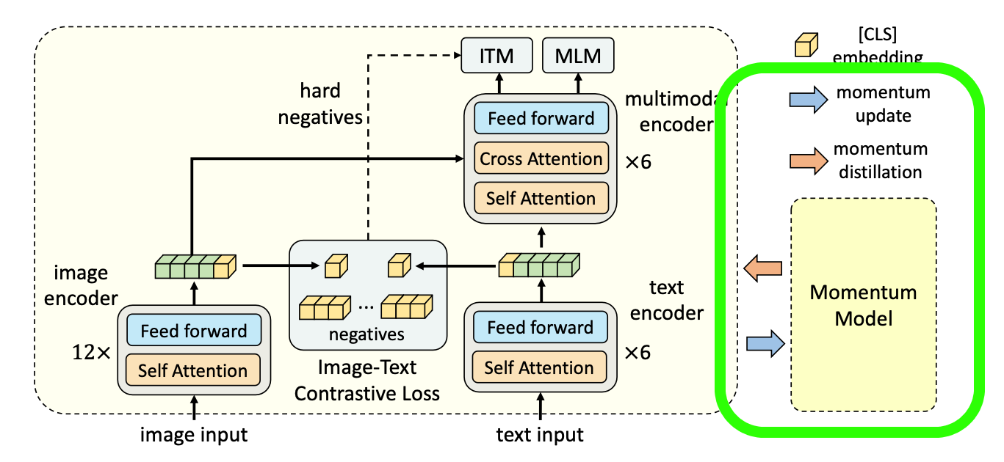
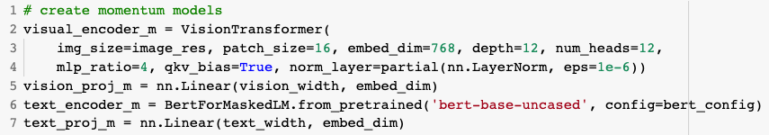
Code
Momentum Model Initialization
Hanbat National University, Dept. of Computer Engineering

Slide 22
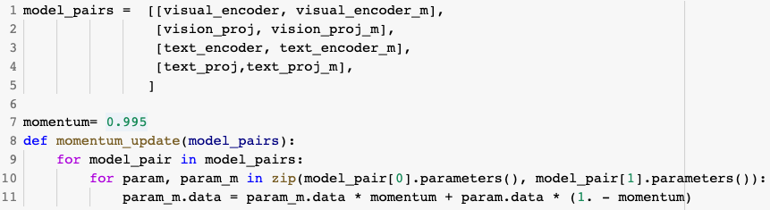
Code
Momentum Model update
Hanbat National University, Dept. of Computer Engineering

Slide 23
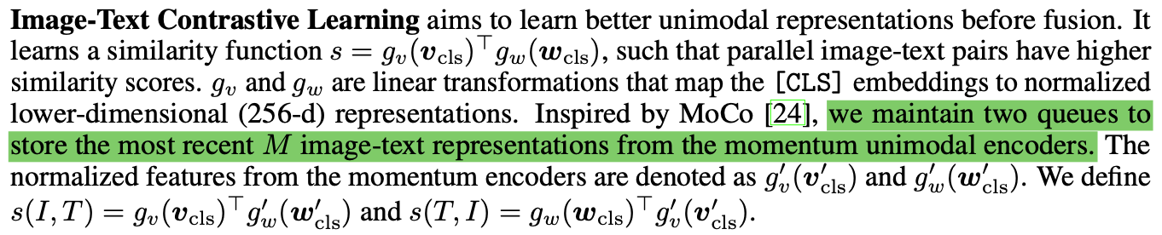
Code
Queue
Hanbat National University, Dept. of Computer Engineering

Slide 24
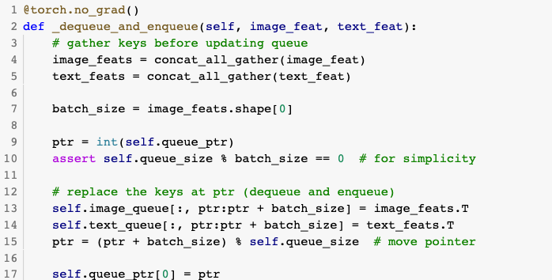
Code
Dequeue and enqueue
Hanbat National University, Dept. of Computer Engineering

Slide 25
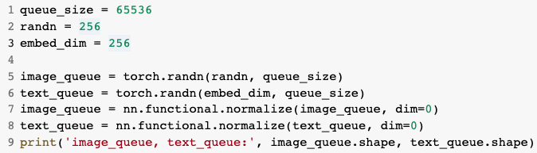
Code
Momentum Model update
Hanbat National University, Dept. of Computer Engineering

Slide 26
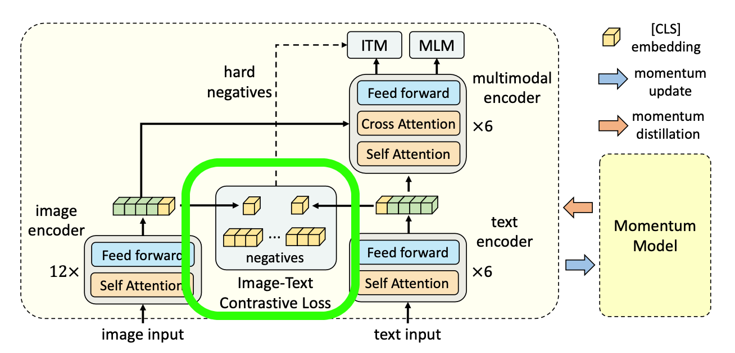
Code
ITC
Hanbat National University, Dept. of Computer Engineering

Slide 27
Code
ITC Loss
Hanbat National University, Dept. of Computer Engineering

Slide 28
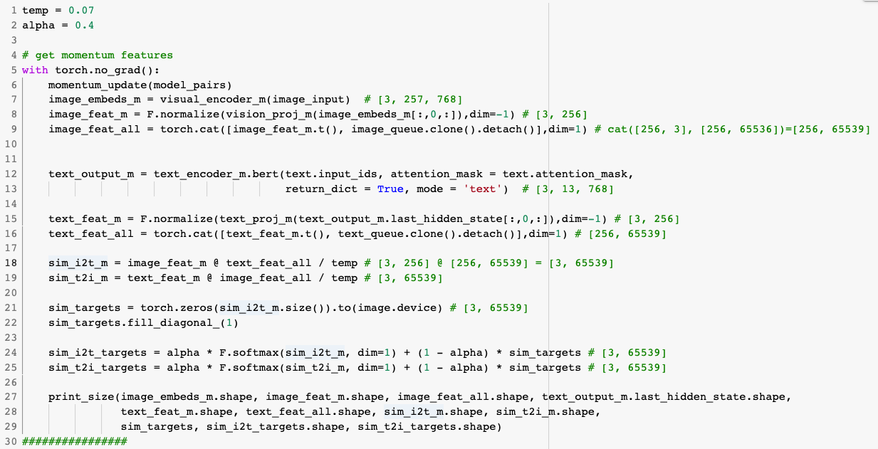
Code
ITC Loss
Hanbat National University, Dept. of Computer Engineering

Slide 29
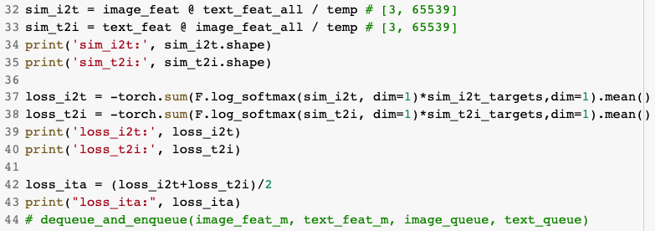
Code
ITC Loss
Hanbat National University, Dept. of Computer Engineering

Slide 30
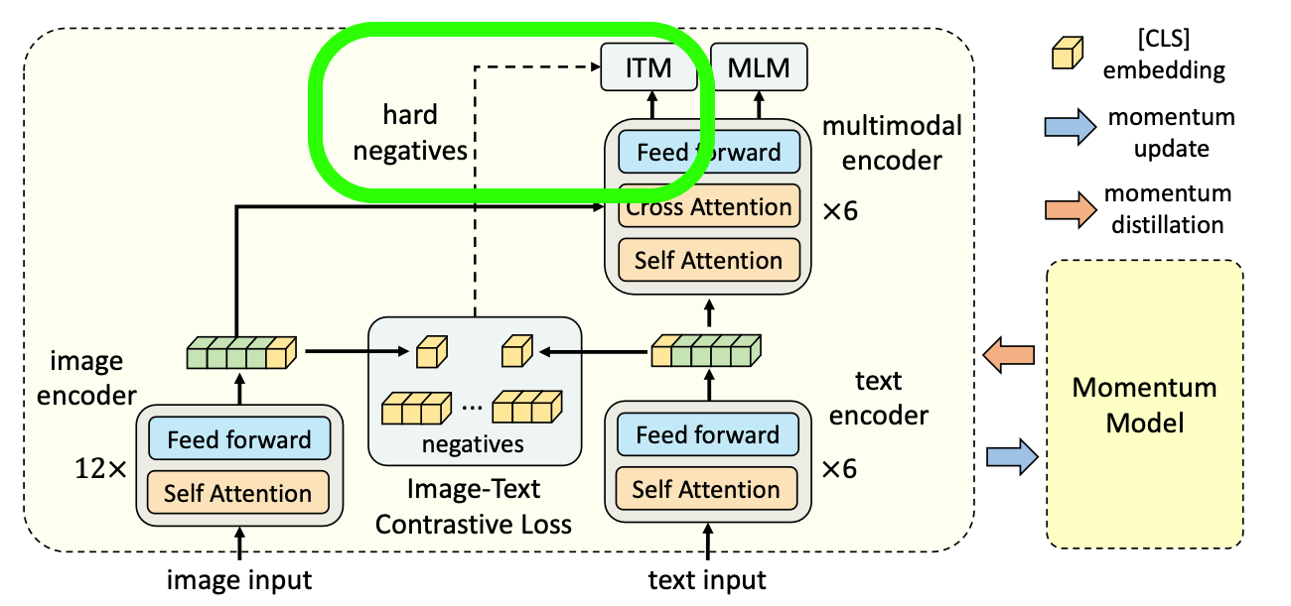
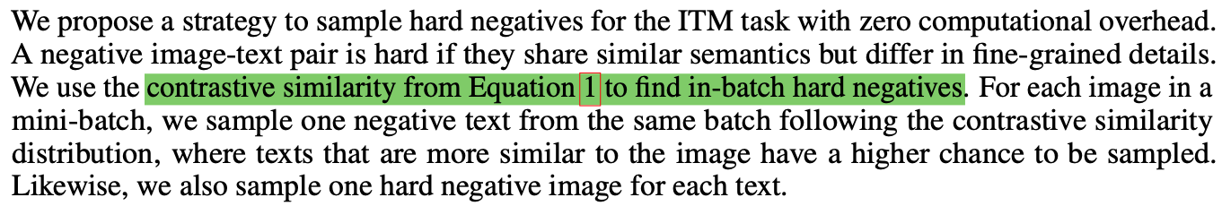
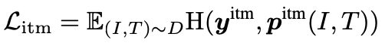
Code
ITM
Hanbat National University, Dept. of Computer Engineering

Slide 31
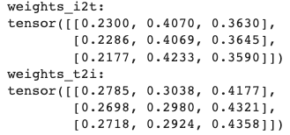
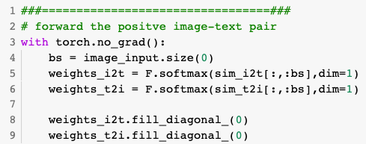
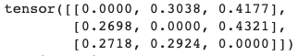
Code
ITM Loss
Hanbat National University, Dept. of Computer Engineering

Slide 32
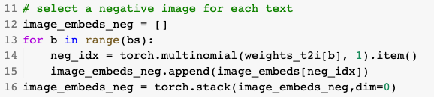
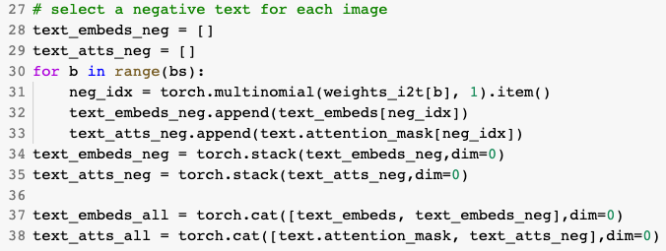
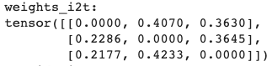
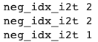
Code
ITM Loss
Hanbat National University, Dept. of Computer Engineering

Slide 33
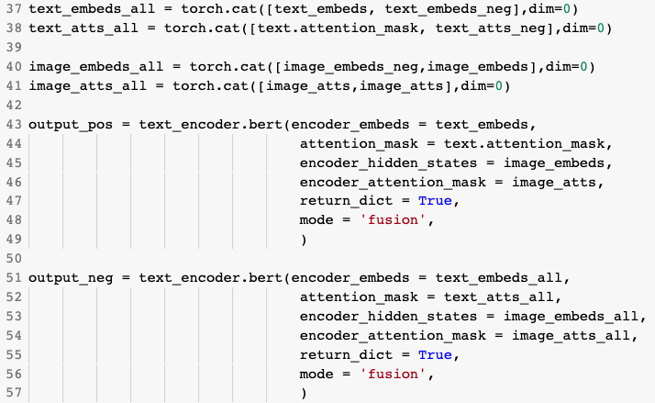
Code
ITM Loss
Hanbat National University, Dept. of Computer Engineering

Slide 34
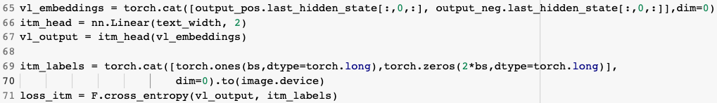
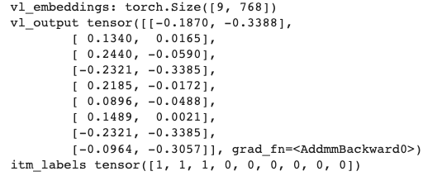
Code
ITM Loss
Hanbat National University, Dept. of Computer Engineering

Slide 35
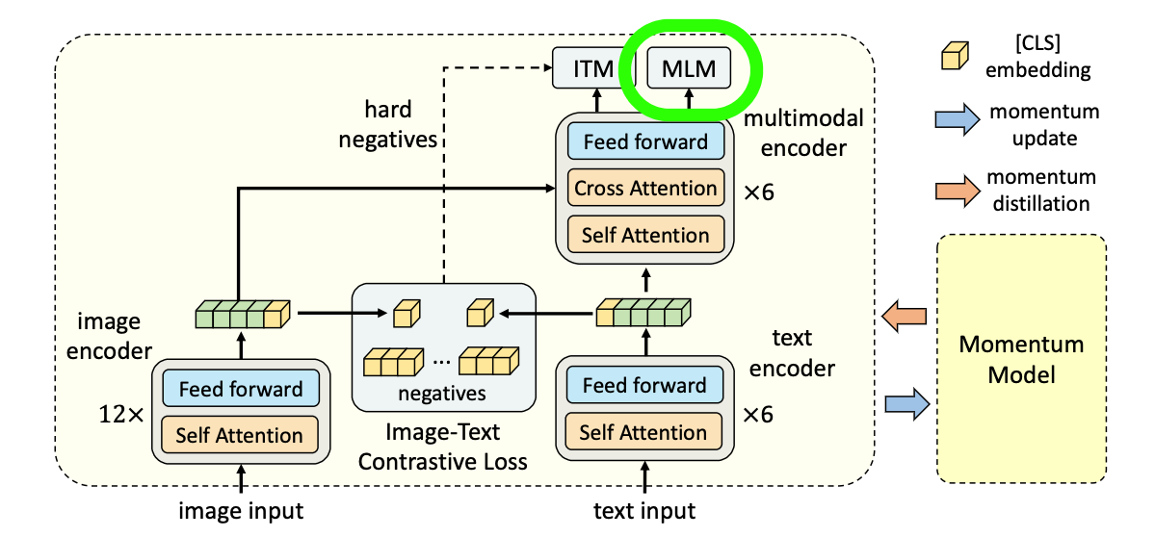
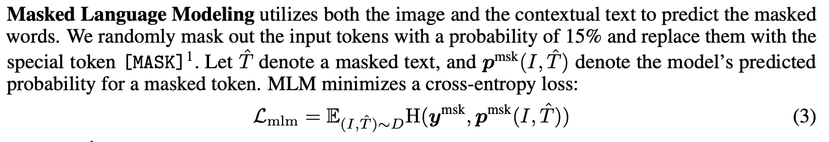
Code
MLM
Hanbat National University, Dept. of Computer Engineering

Slide 36
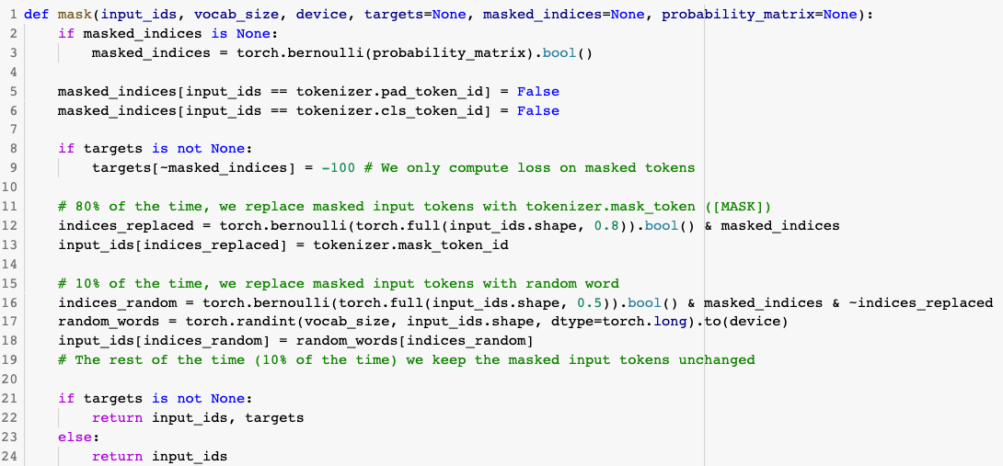
Code
MLM
Hanbat National University, Dept. of Computer Engineering

Slide 37
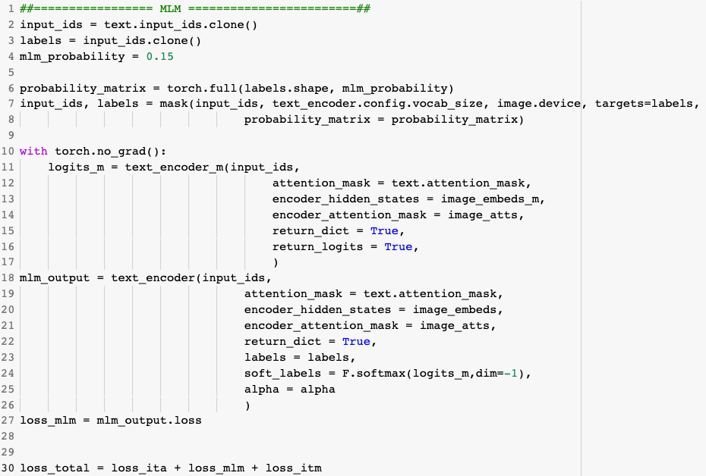
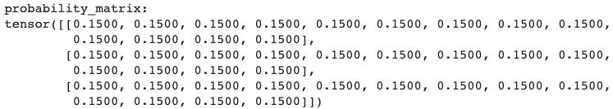
Code
MLM
Hanbat National University, Dept. of Computer Engineering

Slide 38
Thank you
Hanbat National University, Dept. of Computer Engineering

